Slide 1
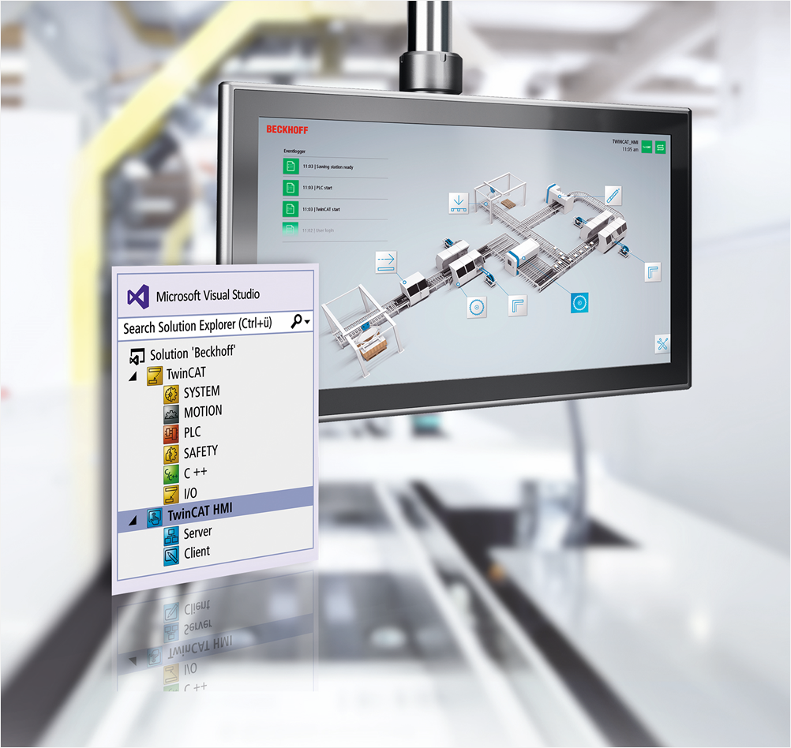
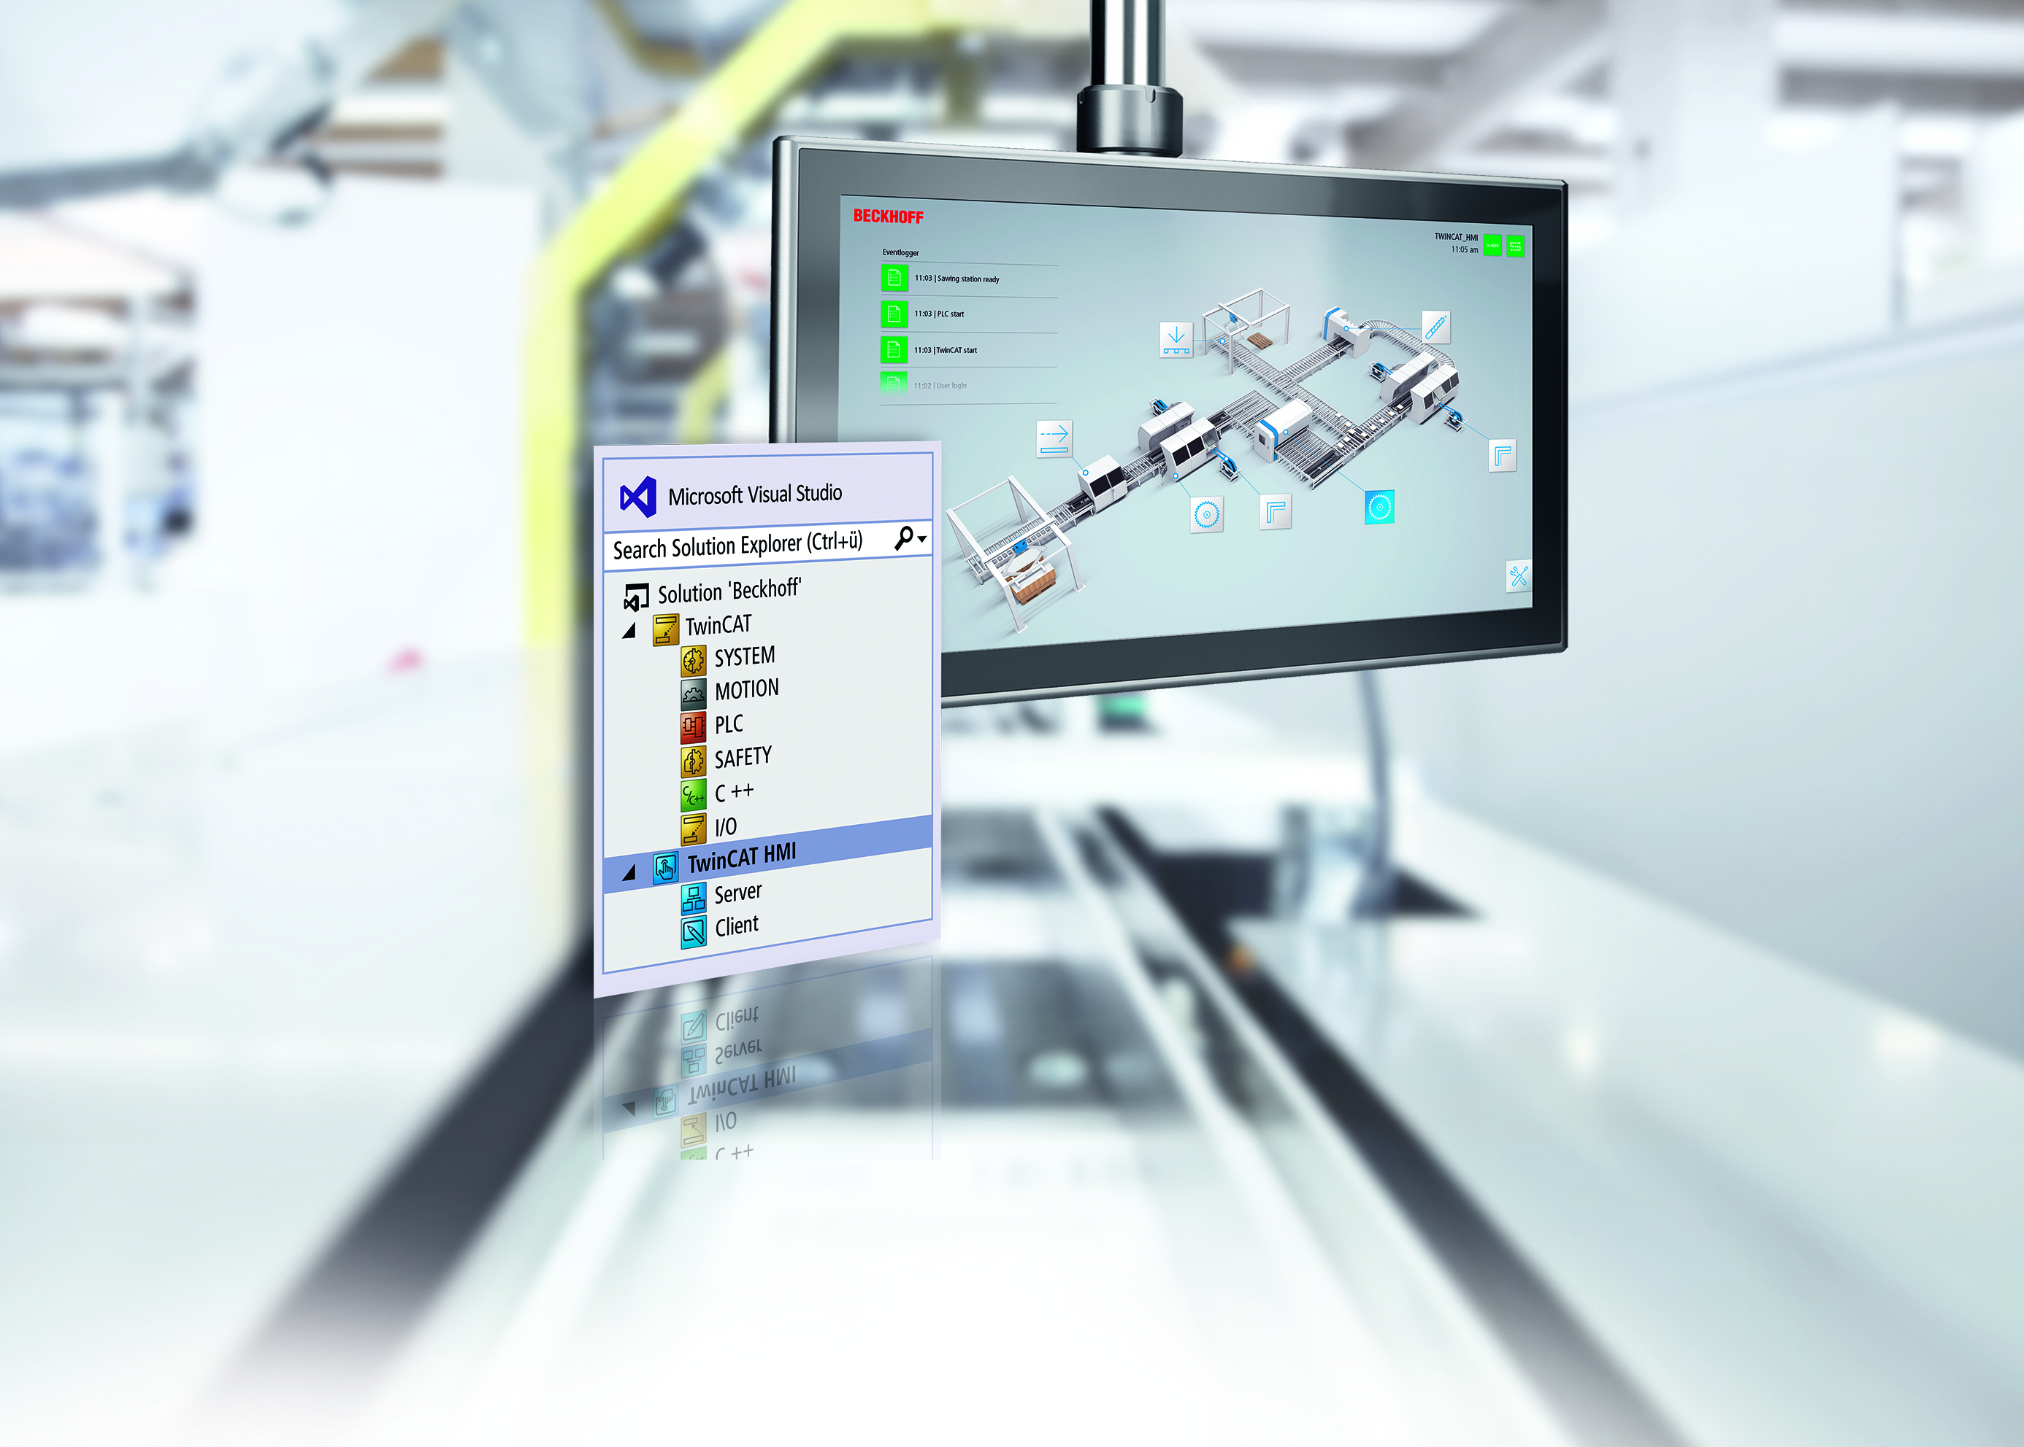
TwinCAT HMI Class I – Agenda

Slide 2
TwinCAT HMI Class I Agenda
TwinCAT HMI Overview
New Features
Sample Application Description
Build Project
HMI Performance and Resource Requirement

